Slide 1

Deep Learning in Retail
Machine Learning in Retail
HUMMARAH SHAHZAD & SAURAV SHAKTI BORAH

Slide 2




1
AGENDA
Introduction
Data Set for the Final Project
Why this Dataset
Dataset Properties
Problem Identification
ML- Project Map
EDA
Data Modification
Modeling
Evaluation Criteria
Business Insights & Way Forward

Slide 3
Data Set for The Project

Slide 4


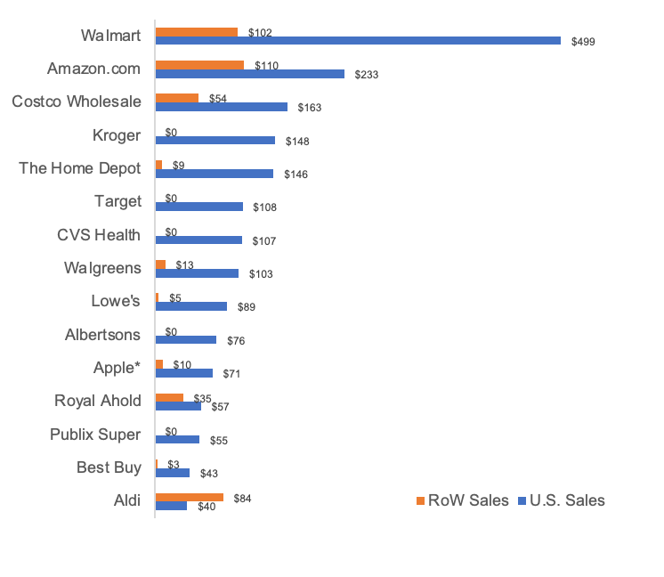





1
KEY PLAYERS IN THE RETAIL UNIVERSE
Walmart, Amazon and Costco make up around 50% of the total sales of in the United States
26%
12%
08%
$499 B
$233 B
$163 B
08%
08%
06%
$148 B
$146 B
$108 B

Slide 5
1
KEY PLAYERS IN THE RETAIL UNIVERSE
Walmart, Amazon and Costco make up around 50% of the total sales of in the United States
26%
12%
08%
$499 B
$233 B
$163 B
08%
08%
06%
$148 B
$146 B
$108 B

Slide 6
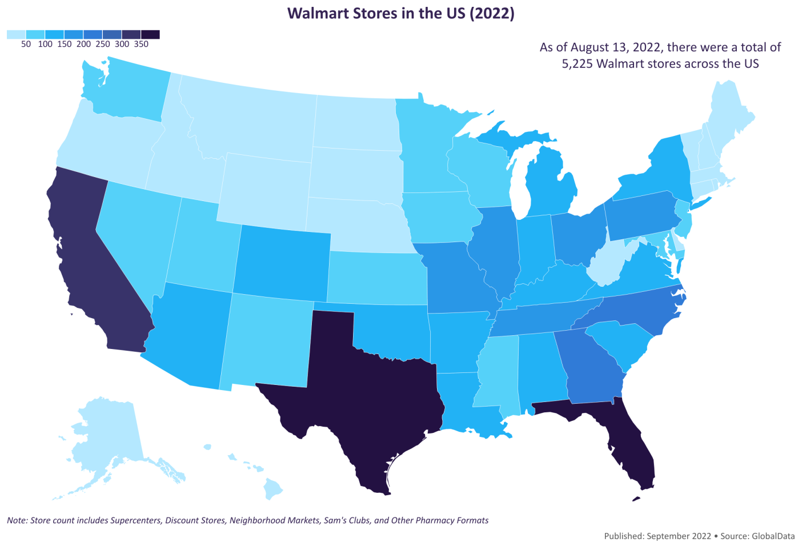
1
KEY PLAYERS IN THE RETAIL UNIVERSE
Geographic spread of Walmart Retail Universe
4,622
Walmart stores
52
States and Territories
509
Stores in Texas

Slide 7

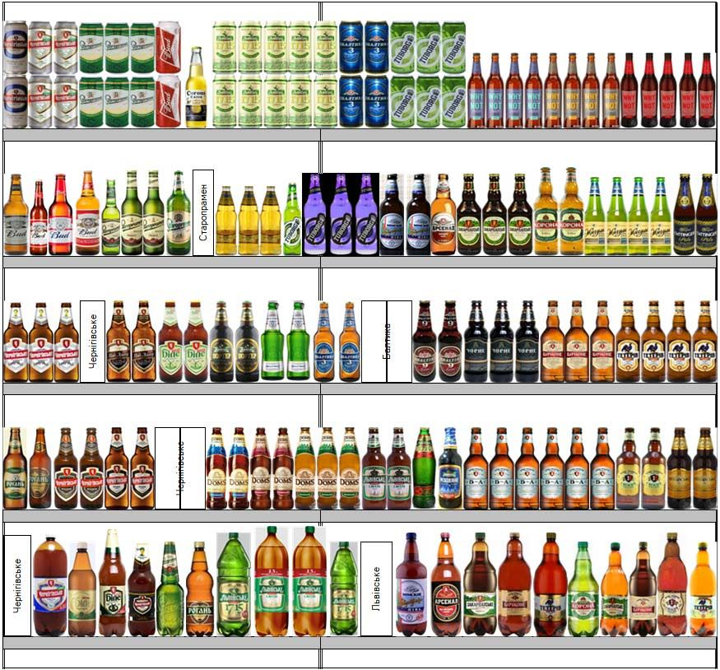


1
STRATEGIC DECISIONS IN RETAIL MANAGEMENT
Accurate Sales Forecasts benefits all players in the retail Universe: Retailers, Customers and Shoppers
Inventory Management
Product Placement
In Store Promotions
Retail Expansion
Accurate sales forecasts enable retailers to plan their inventory levels more effectively. By forecasting future demand, retailers can ensure that they have sufficient stock on hand to meet customer demand while minimizing excess inventory and associated costs
Sales forecasting helps retailers predict demand.
Analyzing historical sales data and considering factors such as seasonality, trends, and promotions, retailers can make informed decisions about which products to display and in what quantities.
Sales forecasting helps retailers assess the potential impact of marketing campaigns and promotions on sales volumes. By forecasting the incremental sales generated by various marketing activities, retailers can allocate their marketing budgets more effectively and optimize their promotional strategies
Sales forecasting plays a crucial role in evaluating the feasibility of expansion plans and new store openings. By forecasting sales for potential new locations or markets, retailers can assess the potential return on investment and make informed decisions about expansion strategies

Slide 8
Data Set Properties

Slide 9

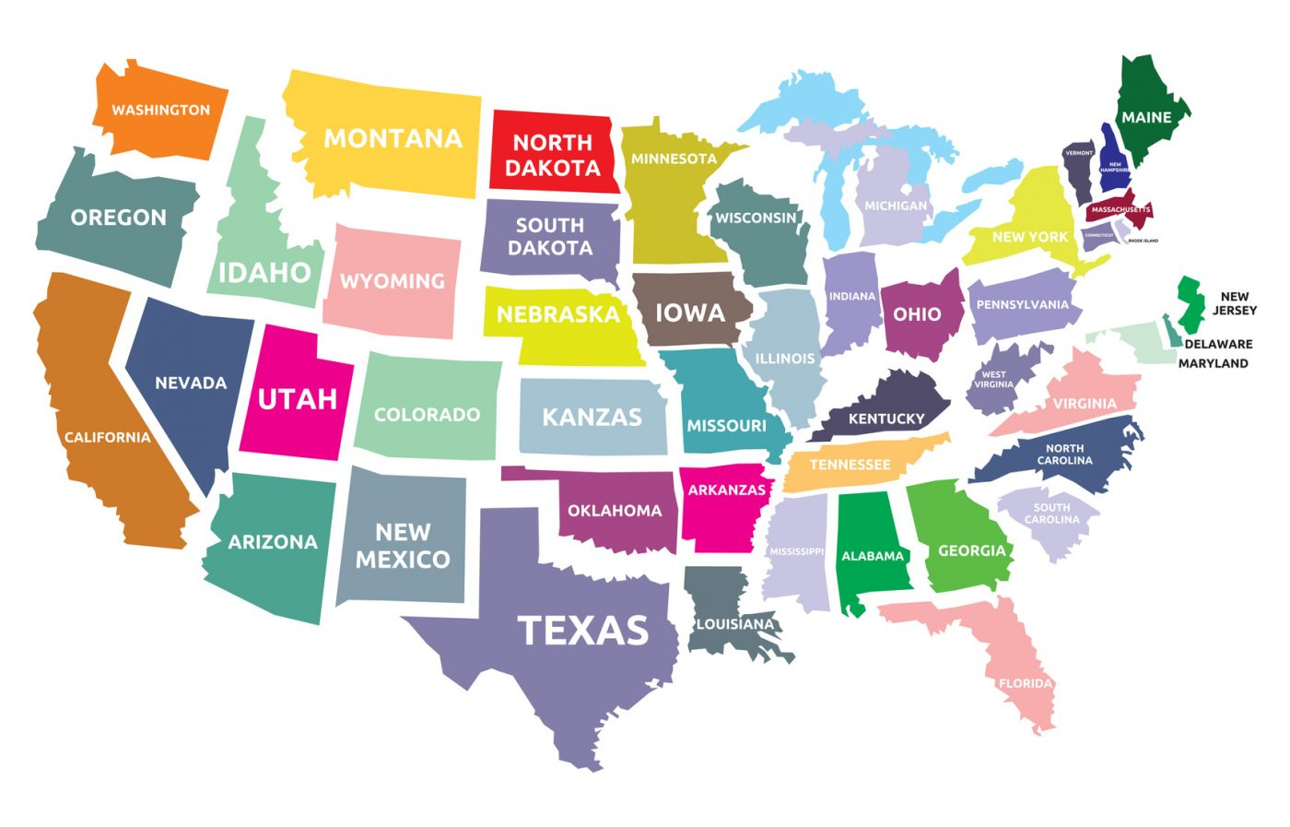


1
DATA SET PROPERTIES
Hierarchical sales data from Walmart, the world’s largest company by revenue, to forecast daily sales for various products falling in 3 different categories: Food, Hobbies and Household
Total No. of Tables
3 Tables: Calendars, Sell Price, Sales Data
Sate wise Data Av.
40% CA, 30% TX and 30% Wisconsin
TX: +9,000 Rows
No. of Rows & Columns
Sales Validation 1919 Columns & 30K Rows
Sell Price 4 Columns & 6.8M Rows
Calendar 14 Columns & 1969 Rows
Event Types & Categories
Max 30 in one column and 4 different Event categories ( Sporting, Cultural, National & Religious)
Notes:
HS

Slide 10
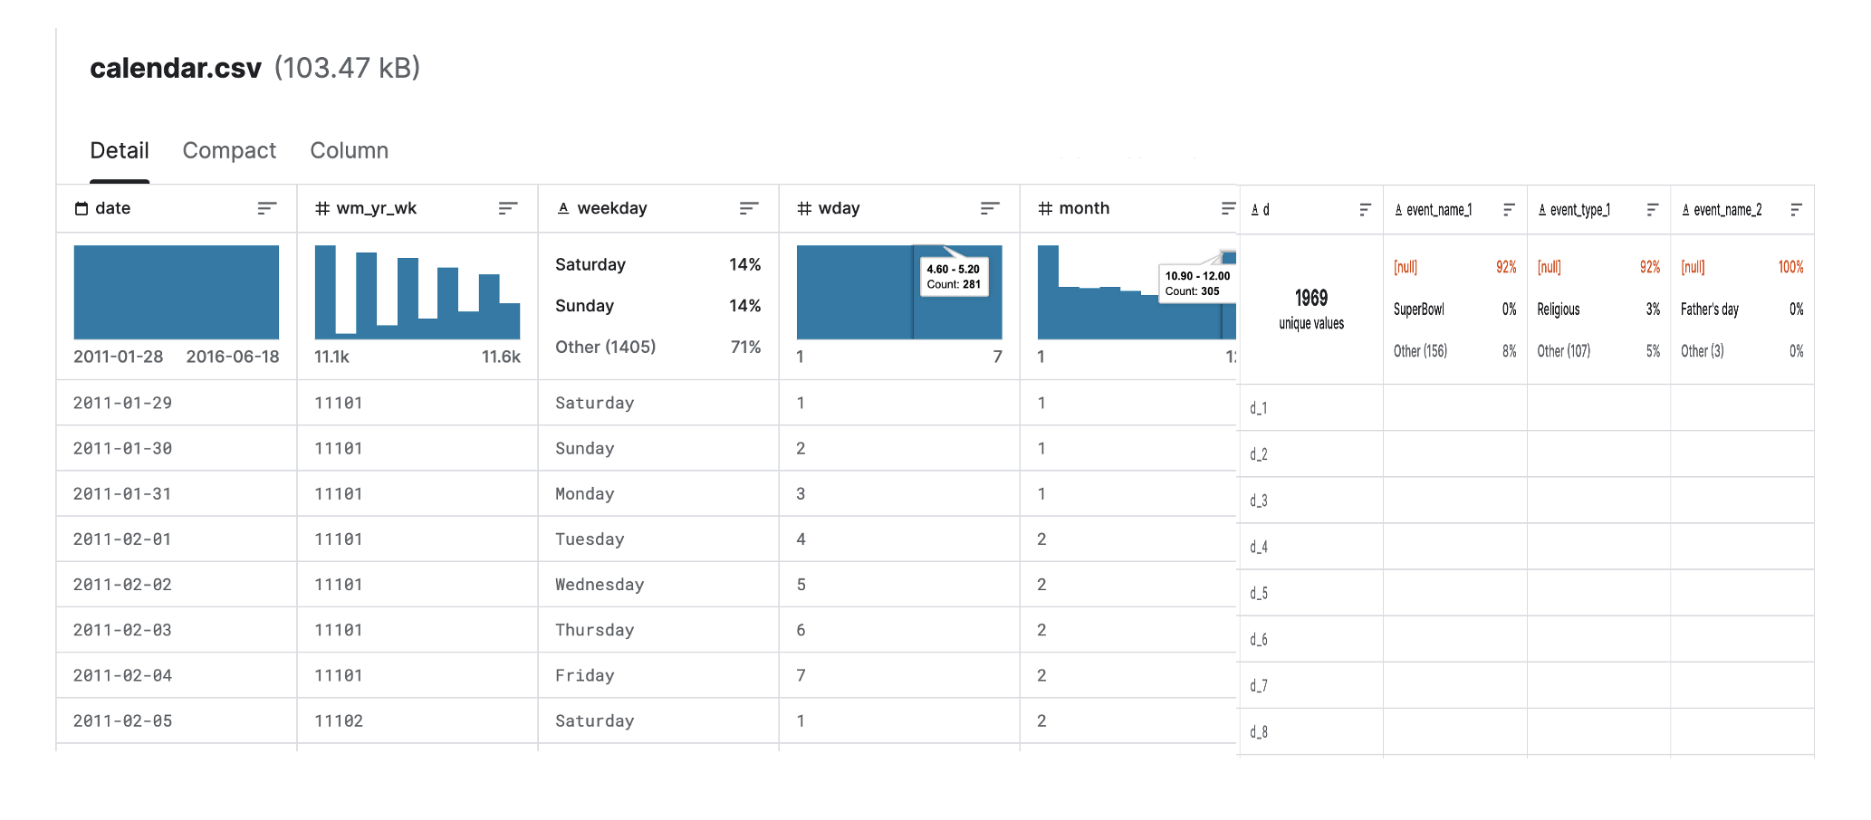
1
DATA SET PROPERTIES
Notes:
HS

Slide 11
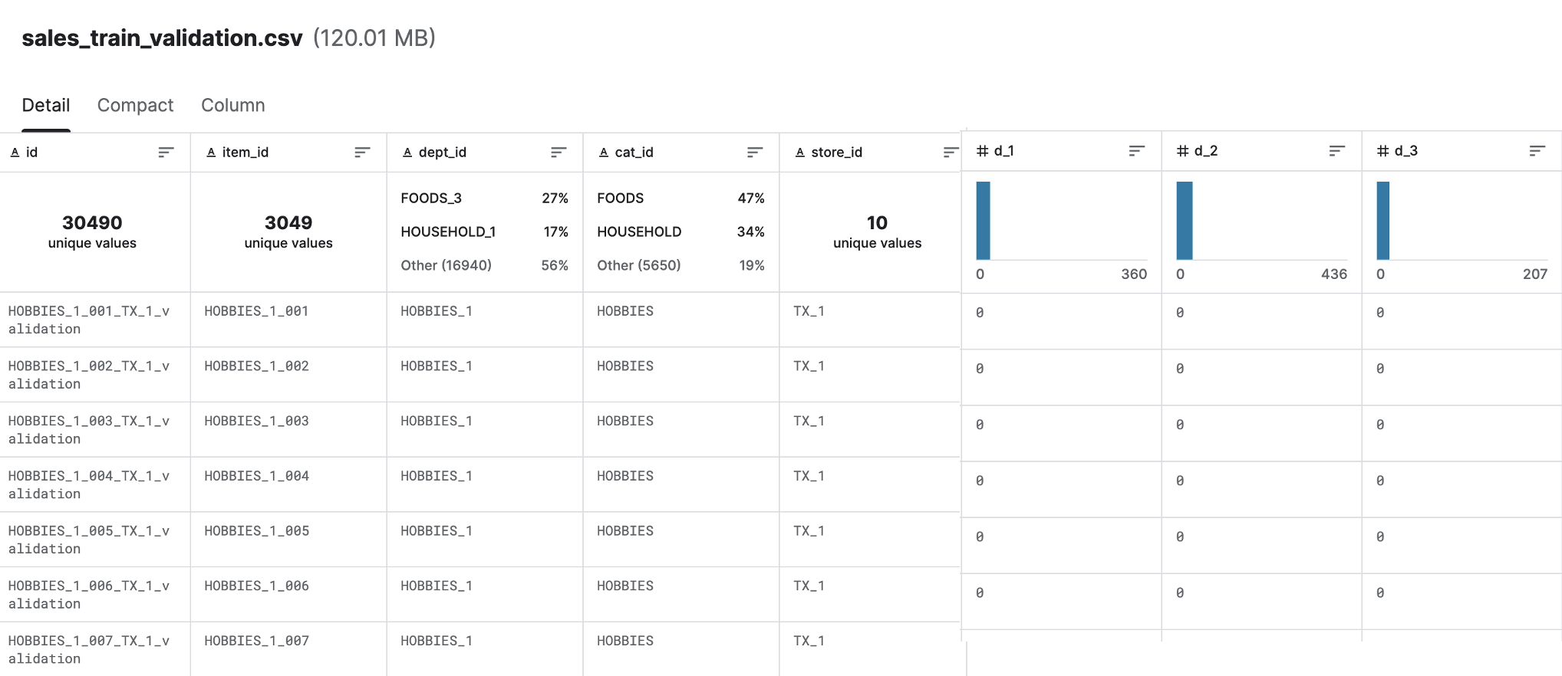
1
DATA SET PROPERTIES
Notes:
HS

Slide 12
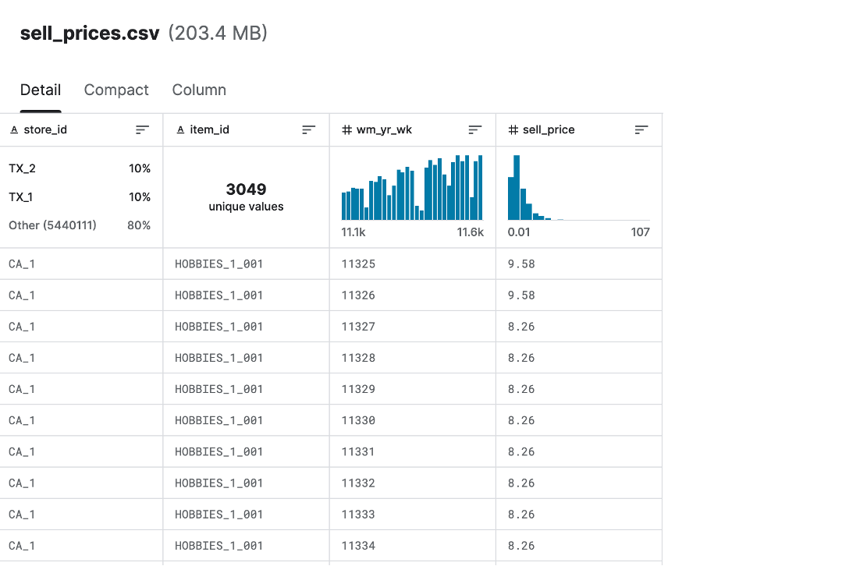
1
DATA SET PROPERTIES
Notes:
HS

Slide 13
MACHINE LEARNING IN PRACTICE

Slide 14



1
PROJECT MAP
Our approach to Walmart Sales Prediction Challenge
Exploratory Data Analysis (EDA)
EDA to identify different trends in the data
Data Modification
Prepared our Data for Extensive Data Modeling
Data Modelling
Tried multiple models to train our data
Evaluation Criteria
Valid ROC
XYZ
Way Forward
Learnings from the project & Possibilities

Slide 15
EXPLORATORY DATA ANALYSIS

Slide 16
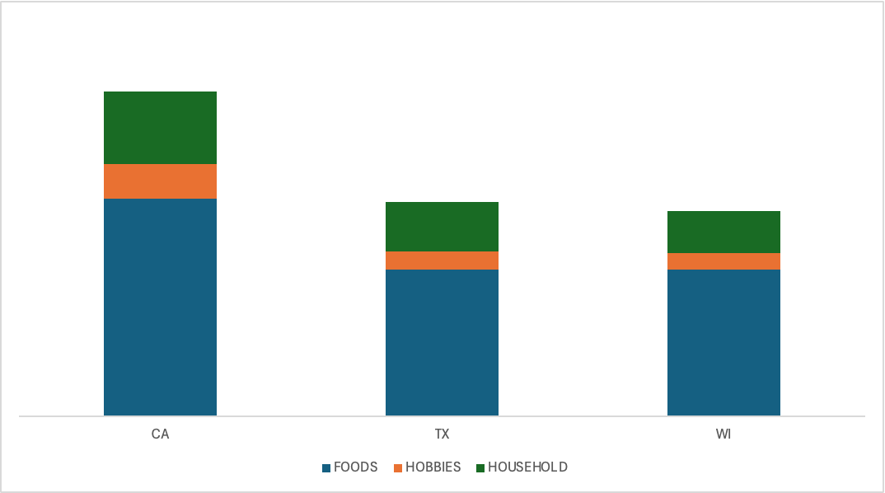
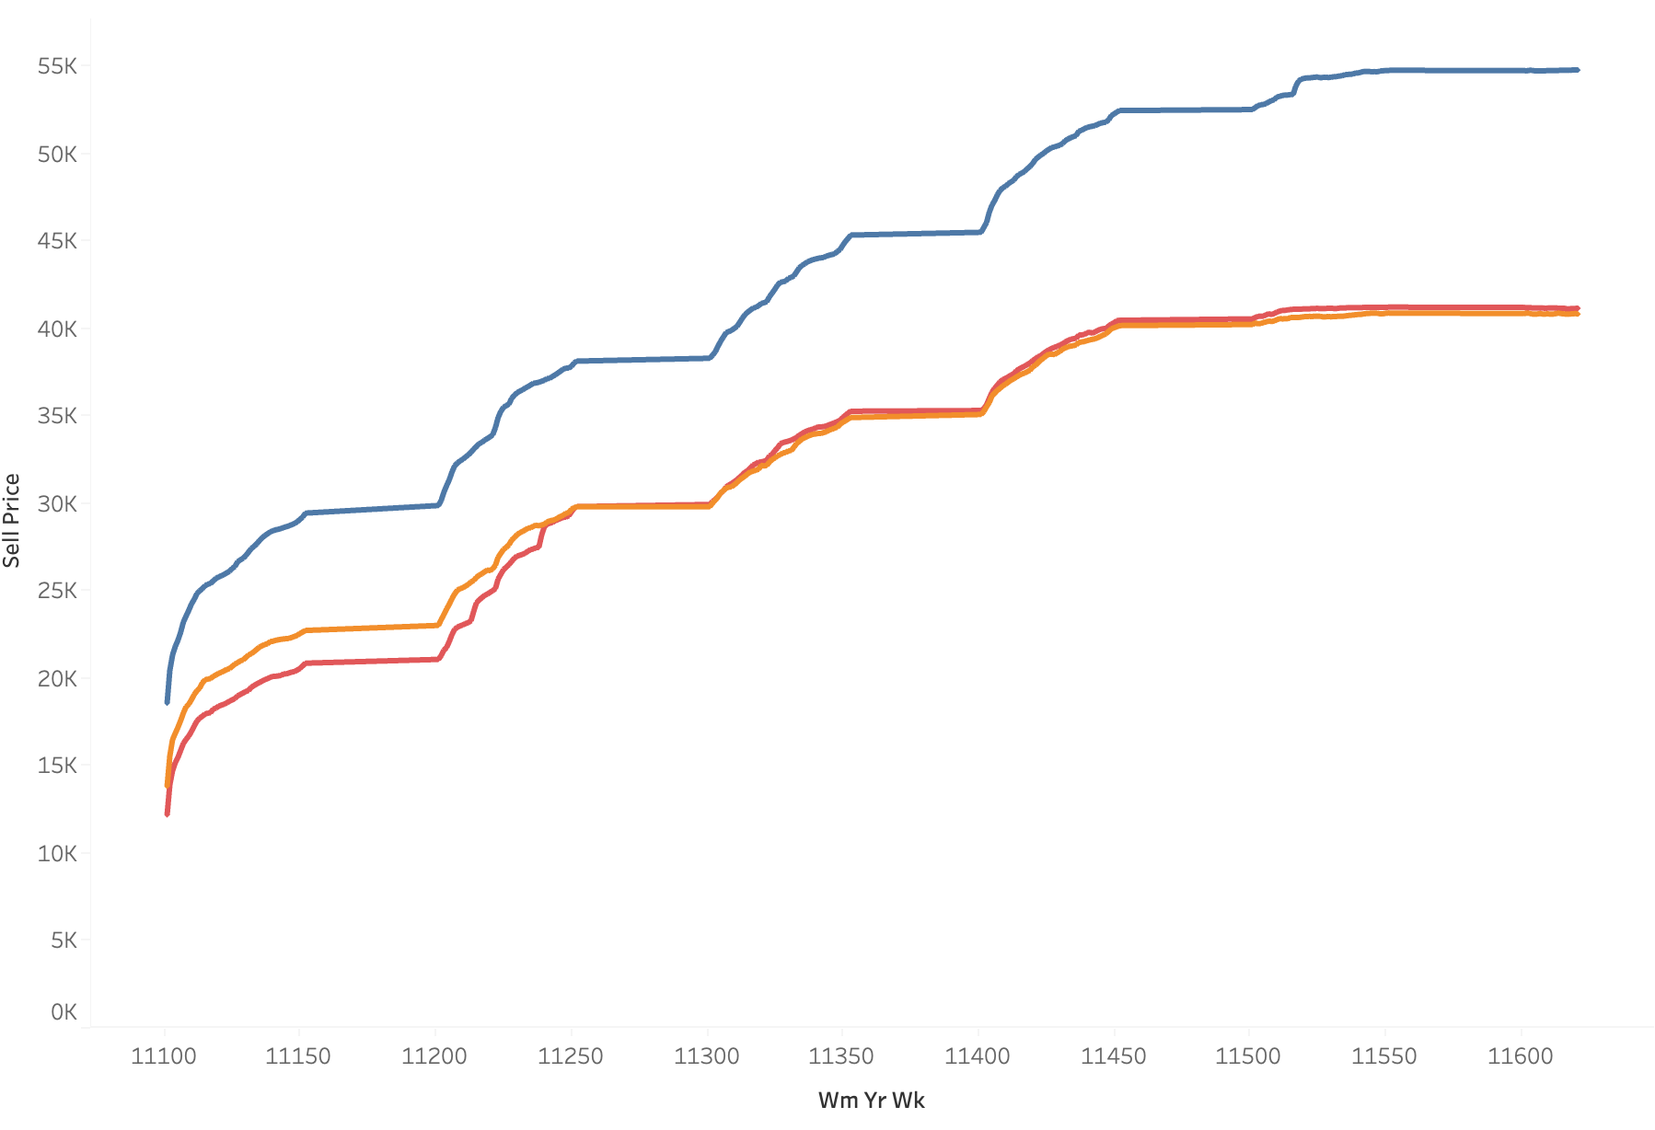
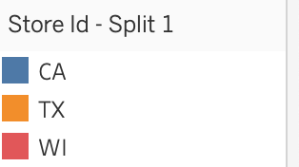
1
Exploratory Data Analysis (EDA)
Identifying various patterns in the given data set
Highest Prices in California, Followed by Wisconsin and then Texas
Highest Total Sales in California, Followed by Texas. Food Category has the highest sales across states followed by Household and Hobbies

Slide 17
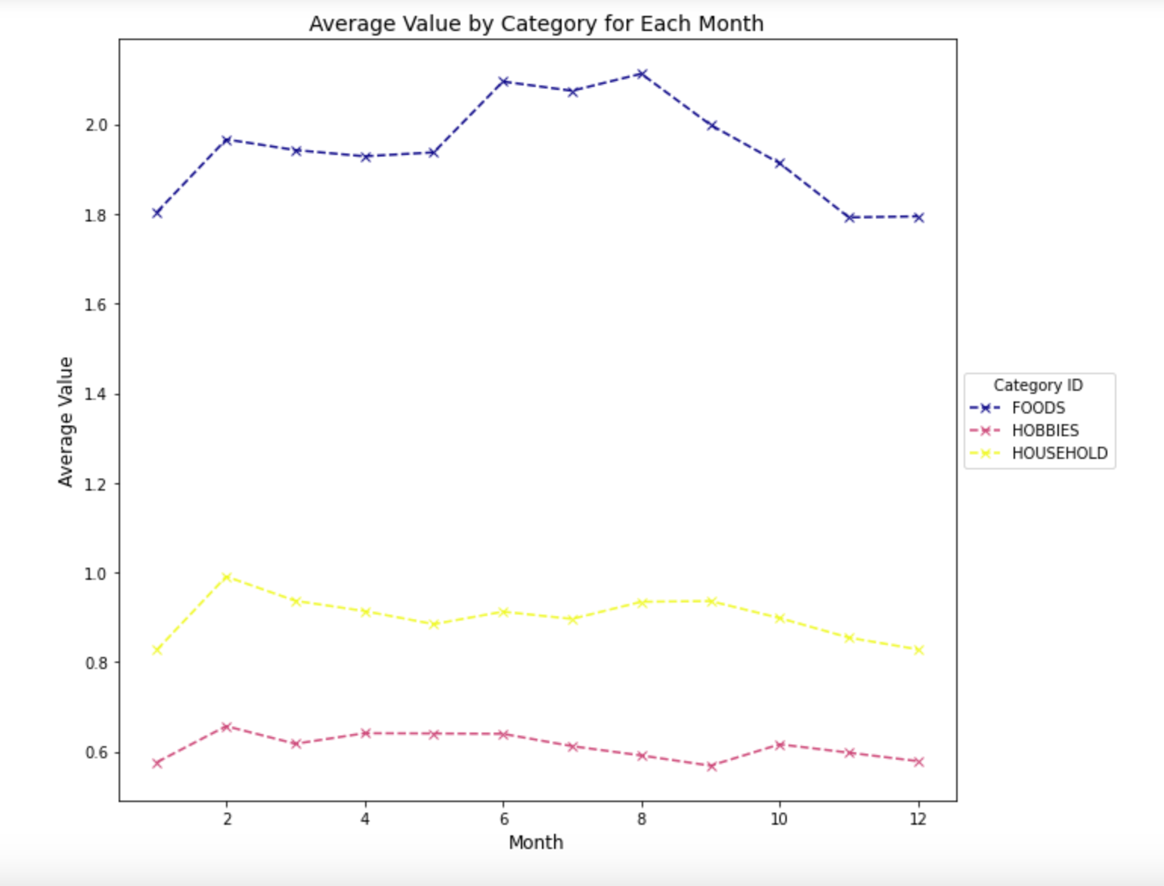
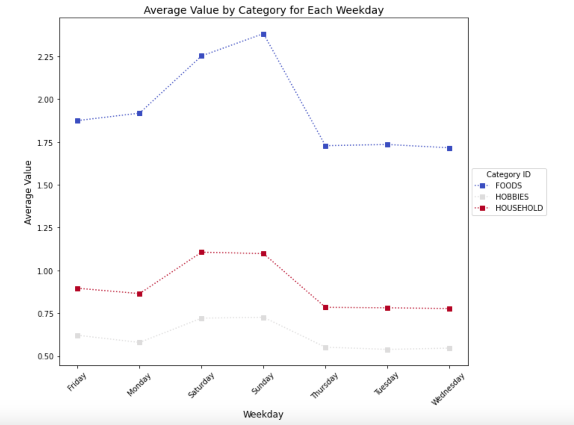
1
Exploratory Data Analysis (EDA)
Identifying various patterns in the given data set
Seasonality Observed in food category over the months
Highest sales over the weekend for all three categories

Slide 18
DATA PRE-PROCESSING

Slide 19
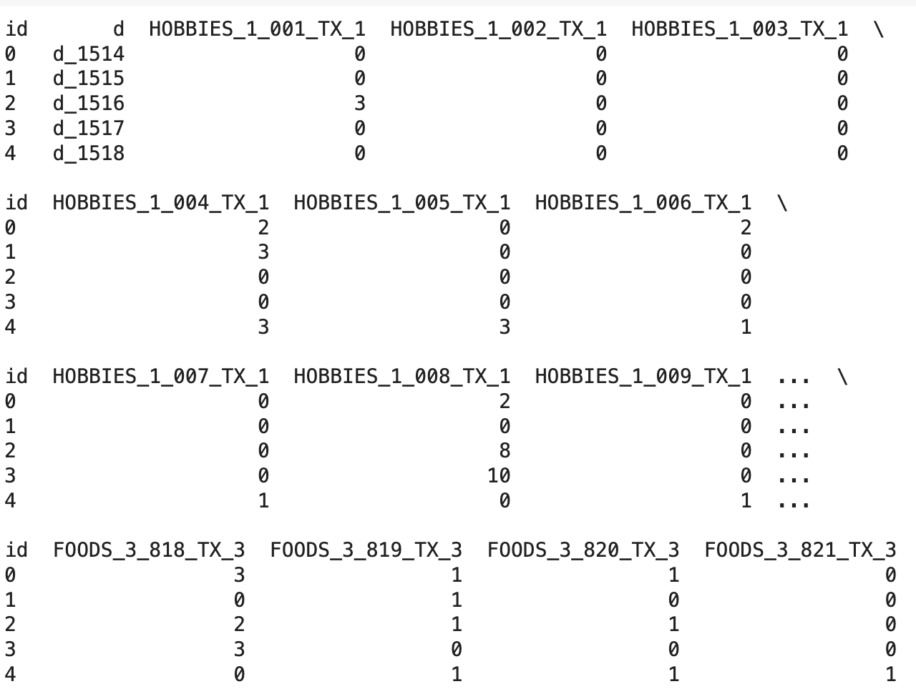
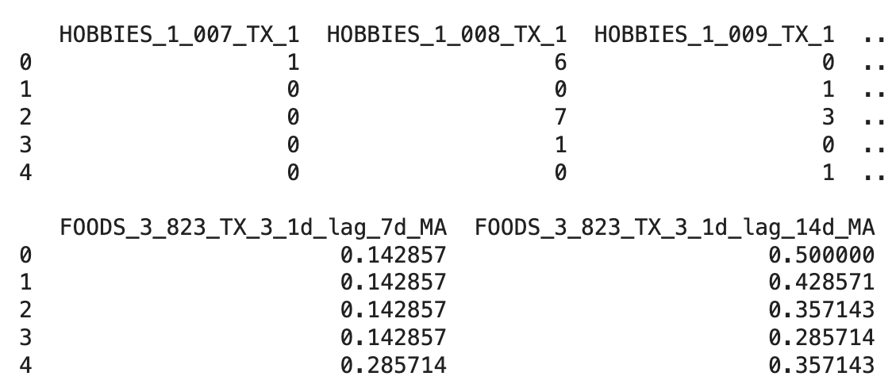
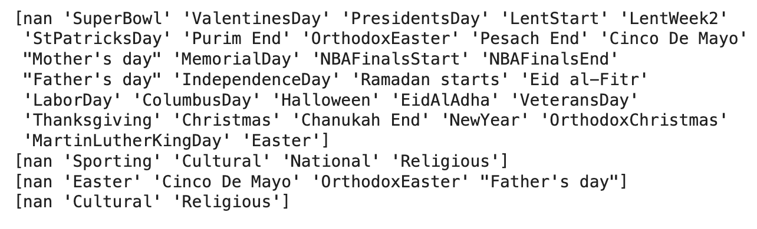
Data Preprocessing & Feature Engineering
Data preprocessing enhances the quality and reliability of the data, paving the way for more accurate and meaningful insights
Modify Sales Data
Lag & Moving Averages
Calendar Table
New Features
Day 1 Lag Applied
7 days and 14 days moving averages
Filter Data to remove NAN
Label Encoder assigns a unique integer to each unique value in a categorical feature
Event Types and Event Names in each column coded to a unique value
Merged Sales Data with Calendar’s
Texas Stores
Drop Irrelevant Columns
ID Column set as Index
Transpose the Sales Data
[5 rows x 9148 columns]
[5 rows x 27442 columns]
[5 rows x 27448 columns]
Notes:
HJ

Slide 20

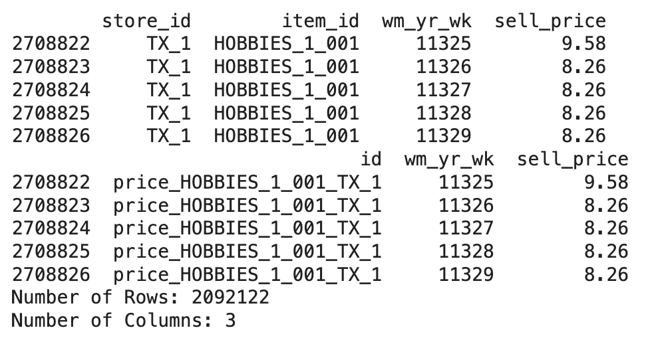
Data Preprocessing & Feature Engineering
Data preprocessing enhances the quality and reliability of the data, paving the way for more accurate and meaningful insights
Modify Sell Price Data
Enhance Data Quality
Pivot the DataFrame to make 'd' values columns, 'id' as the index, and 'sell_price' as the values
Transpose the table
Reduce Overfitting Risk
Ensure Data Integrity
Preprocessed Dataset
Down casting for faster processing
Improve Model Performance
[5 rows x 36595 columns]
Notes:
HJ

Slide 21
Data Modelling & Cross Validation

Slide 22
1
Data Modeling to Predict Sales | LSTM
METHODOLOGY
Pre-processed merged dataset having 36k+ features including sales, price, moving averages and calendar events data.
Dynamically allocated GPU memory to processes as needed, rather than allocating all of the GPU's memory upfront.
Dropped features with constant values for all rows and removed columns with NaN Values to prevent Minmaxscaler from giving NaN values as output. Number of features reduced to 30k.
TIME SERIES forecasting using Look back period 40 days and a forecast Horizon of 28 days each. This process is repeated moving one time step forward creating 3D arrays of (sample, time steps, features) for both input and target datasets.
Training Data: 80%. Test Data: 20%
For training, the training data i.e. the 3d array is divide across the first dimension, which corresponds to the samples, meaning batch size equal to the sample the 3d array
Notes:
Part 1:
Pre-processed merged dataset having 36k+ features including sales, price, moving averages and calendar events data.
Dynamically allocated GPU memory to processes as needed, rather than allocating all of the GPU's memory upfront. This is particularly useful when running multiple machine learning models or processes that require GPU resources simultaneously, as it allows for more efficient use of the GPU's memory.
Dropped features with constant values for all rows and removed columns with NaN Values to prevent Minmaxscaler from giving NaN values as output. Number of features reduced to 30k.
Prepared the dataset for time series forecasting by specifying a Look back period and a forecast Horizon of 28 days each. This process is repeated moving one time step forward creating 3D arrays of (sample, time steps, features) for both input and target datasets.
Then, it splits the prepared dataset into training and testing sets, allocating 80% of the data for training and the remaining 20% for testing.
For training, the training data i.e. the 3d array is divide across the first dimension, which corresponds to the samples, meaning batch size equal to the sample the 3d array
After training, the model is evaluated by predicting on the test set, reshaping the predicted output for comparison with the true values, and calculating the root mean squared error (RMSE) as the performance metric. It also demonstrates how to inverse transform the scaled data back to its original scale for more interpretable evaluation.
RMSE value on normalised set = 0.2748
RMSE value on inversed set=1.589

Slide 23
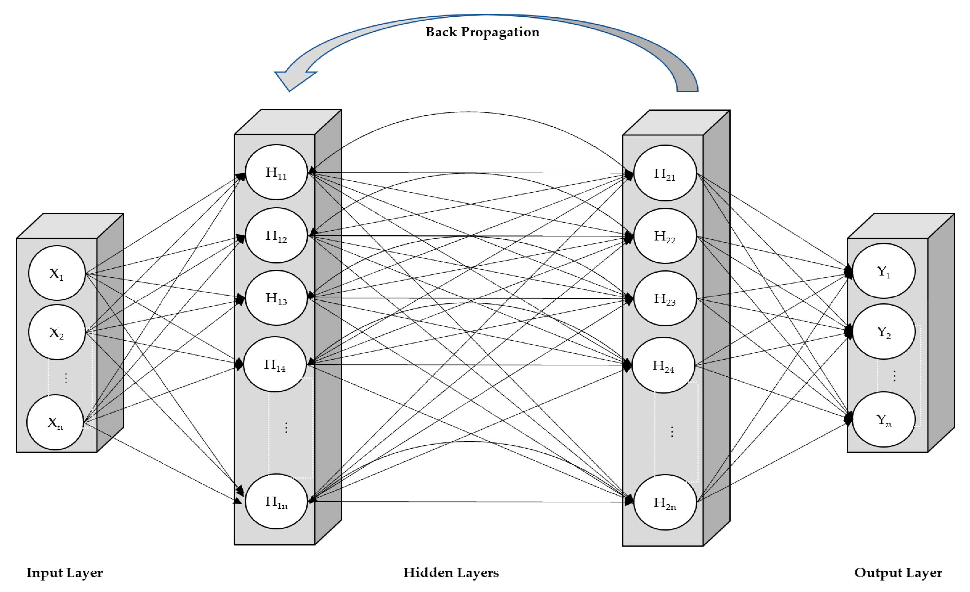
1
Data Modeling to Predict Sales | LSTM
MODEL STRUCTURE
Notes:
Model Type: "Sequential" indicates that the model is a linear stack of layers where each layer has exactly one input tensor and one output tensor.
Layers:
LSTM Layer (lstm_2): The first layer is an LSTM (Long Short-Term Memory) layer with an output shape of (None, 28, 50). The None indicates that the batch size can vary, 28 is the sequence length, and 50 is the number of LSTM units in the layer. This layer has 5,997,600 parameters, which are the weights the LSTM needs to learn during training. LSTM layers are used for processing sequences (like time series data or text) because they can remember information for long periods, which is useful for capturing long-term dependencies in the data.
LSTM Layer (lstm_3): The second LSTM layer outputs a shape of (None, 50), which means for each sequence input, it produces a single 50-dimensional vector. This is achieved by not returning the sequences, thus only outputting the last step's output. It has 20,200 parameters.
Dense Layer (dense_1): Following the LSTM layers, there's a dense (fully connected) layer with an output shape of (None, 838,236). This layer has 42,750,036 parameters, indicating a very high number of weights to be learned. Dense layers are typically used for outputting predictions from the network. The large number of output units suggests this layer is probably meant for tasks like classification with a large number of classes or for generating a very high-dimensional output.
Reshape Layer: The final layer is a reshape layer that changes the shape of its input to (None, 28, 29,937) without changing its data. This layer has 0 parameters because it does not learn anything; it merely reshapes the data. The specific shape suggests that the model's output is being structured in a particular way, possibly to match some desired output format or to prepare the data for further processing in a specific shape.

Slide 24
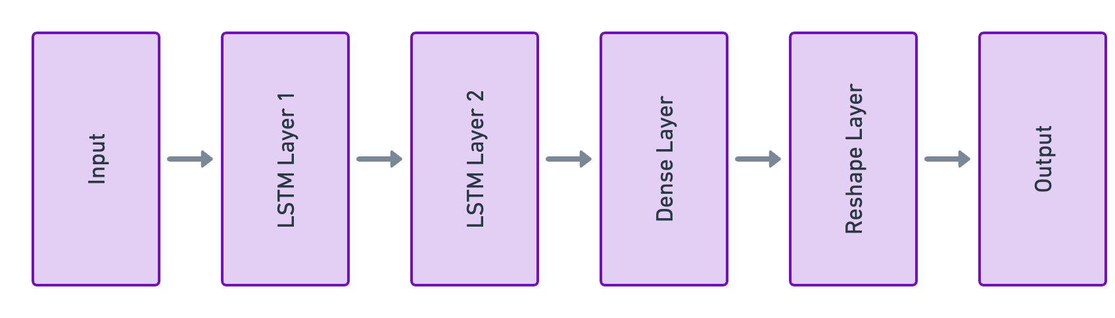
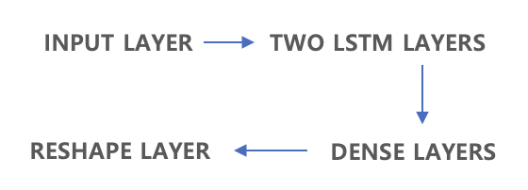
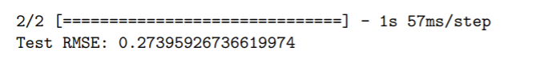
1
Data Modeling to Predict Sales | LSTM
MODEL STRUCTURE
FEATURES & EVALUATION
Model Type: "Sequential" - A linear stack of layers, straightforward and simple architecture.
EPOCH 100
BATCH SIZE 32
ADAM OPTIMIZER
PATIENCE: 10
First layer with an output shape of (None, 28, 50). The None indicates that the batch size can vary, 28 is the sequence length, and 50 is the number of LSTM units in the layer. This layer has 5,997,600 parameters.
Produces a 50-dimensional output vector for each input sequence with
20,200 parameters.
Fully connected layer with a massive 838,236 units, containing 42,750,036 parameters for high-dimensional output tasks.
Changes the shape of its input to (None, 28, 29937) for specific output formatting, has 0 parameters.
Instances of 28 days time period data with each day having 29937 features are used as target for training and compared with the output to calculate MSE loss
ACTIVATION FUNCTION: Sigmoid
Several instances/samples of time period data with each day having 29937 features are used as input for training
LOSS MEAN SQUARED ERROR
Root mean squared error (RMSE) as the performance metric.
Notes:
Model Type: "Sequential" indicates that the model is a linear stack of layers where each layer has exactly one input tensor and one output tensor.
Layers:
LSTM Layer (lstm_2): The first layer is an LSTM (Long Short-Term Memory) layer with an output shape of (None, 28, 50). The None indicates that the batch size can vary, 28 is the sequence length, and 50 is the number of LSTM units in the layer. This layer has 5,997,600 parameters, which are the weights the LSTM needs to learn during training. LSTM layers are used for processing sequences (like time series data or text) because they can remember information for long periods, which is useful for capturing long-term dependencies in the data.
LSTM Layer (lstm_3): The second LSTM layer outputs a shape of (None, 50), which means for each sequence input, it produces a single 50-dimensional vector. This is achieved by not returning the sequences, thus only outputting the last step's output. It has 20,200 parameters.
Dense Layer (dense_1): Following the LSTM layers, there's a dense (fully connected) layer with an output shape of (None, 838,236). This layer has 42,750,036 parameters, indicating a very high number of weights to be learned. Dense layers are typically used for outputting predictions from the network. The large number of output units suggests this layer is probably meant for tasks like classification with a large number of classes or for generating a very high-dimensional output.
Reshape Layer: The final layer is a reshape layer that changes the shape of its input to (None, 28, 29,937) without changing its data. This layer has 0 parameters because it does not learn anything; it merely reshapes the data. The specific shape suggests that the model's output is being structured in a particular way, possibly to match some desired output format or to prepare the data for further processing in a specific shape.

Slide 25
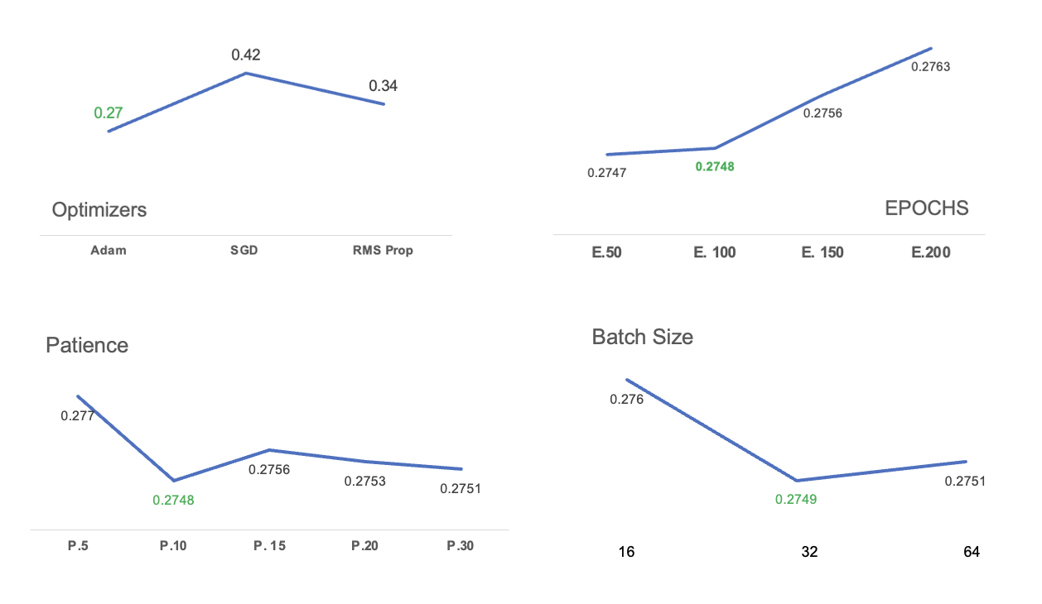
1
Data Modeling to Predict Sales | HYPER PARAMETERS
HYPERPARAMETER TUNING
Best Picks
OPTIMIZERS - ADAM
EPOCH - 100
Patience - 10
Batch Size - 32

Slide 26
Key Learnings & Future Scope

Slide 27

1
Machine Learning in Retail
Optimized Inventory Management
Risk Mitigation
LSTM-based forecasts enable retailers to anticipate future sales volumes with greater accuracy, allowing them to adjust inventory levels accordingly and reduce holding cost
By anticipating future sales trends and market dynamics, retailers can proactively mitigate risks associated with factors such as inventory obsolescence, economic downturns, and changing consumer preferences.
Competitive Advantage
Targeted Pricing & Promotions
LSTM-based sales forecasts enable retailers to identify sales patterns, seasonal trends, and customer preferences more accurately. This information can be used to design targeted marketing campaigns and promotional activities that resonate with specific customer segments
Accurate sales forecasting powered by LSTM models can provide retailers with a competitive advantage in the marketplace.

Slide 28




1
Machine Learning in Retail FUTURE SCOPE
Advanced Machine Learning Techniques: While LSTM networks have shown effectiveness in modeling sequential data such as sales time series, future advancements in machine learning techniques may introduce even more sophisticated models capable of capturing complex patterns and dependencies in sales data. This could involve the development of hybrid models combining different types of neural networks, reinforcement learning approaches, or attention mechanisms.
Integration of External Data Sources: Incorporating a wider range of external data sources into sales forecasting models can enhance their predictive accuracy and robustness. Future developments may involve integrating data from sources such as social media, web traffic, demographic information, economic indicators, and geopolitical events to provide a more comprehensive understanding of market dynamics and consumer behavior.
Interpretability: As sales forecasting models become more complex and sophisticated, there will be an increasing need for interpretability and explain ability to gain insights into model predictions and decision-making processes. Future developments may focus on enhancing the transparency and interpretability of forecasting models through techniques such as model visualization, feature importance analysis, and explanation generation.

Slide 29
Thank You

Slide 30

MACHINE LEARNING IN Finance

Slide 31
1
KEY FINANCE TERMINOLOGIES
Stock Price Returns
Appreciation in price + dividends paid /original price of stock.
Portfolio Strategy
Buy top decile - Most positive earnings
Sell bottom decile – Most negative earnings
Excess Returns -
Returns achieved above and beyond the return of a proxy.
Excess returns will depend on a designated investment return comparison for analysis.
Riskless Rate
Benchmarks
Notes:
HS

Slide 32
1
KEY FINANCE TERMINOLOGIES
Sharpe Ratio
Gauge the performance of an investment by adjusting for its risk
The higher the ratio, the greater the investment return relative to the amount of risk taken, and thus, the better the investment.
The Sharpe ratio has several weaknesses, including an assumption that investment returns are normally distributed.
Notes:
HS

Slide 33
Data Set for The Project

Slide 34




1
DATA SET PROPERTIES & METHADOLOGY
Stock Return
Monthly
18719
Stocks
690
Months
64 Features
2219316×64
feature matrix 𝑋 size
Notes:
HS

Slide 35



1
DATA SET PROPERTIES & METHADOLOGY
42
Trials
Stock Return
Monthly
Each Trial: Lag by 1 year until 2019 from 1963.
Training set : t+0 to t+9 (120 months)
Validation set : t+10 to t+14 (60 months)
Test set :t+15 (12months)
Stock return prediction for all stocks in year t + 15.
Portfolio to buy stocks with top decile and sell stocks with bottom decile.
Obtain portfolio returns for each month within the year t + 15
With 42 trials, collect portfolio returns for 42× 12 m
Notes:
HS

Slide 36
Hyper Parameter Tuning

Slide 37
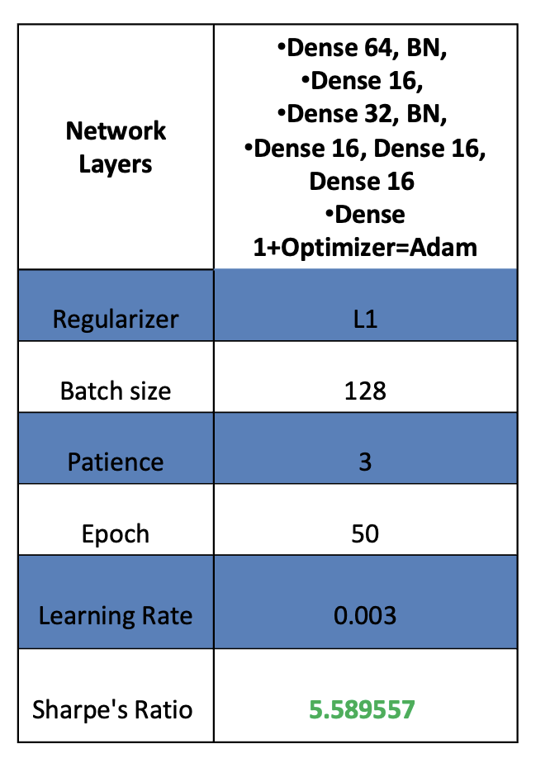
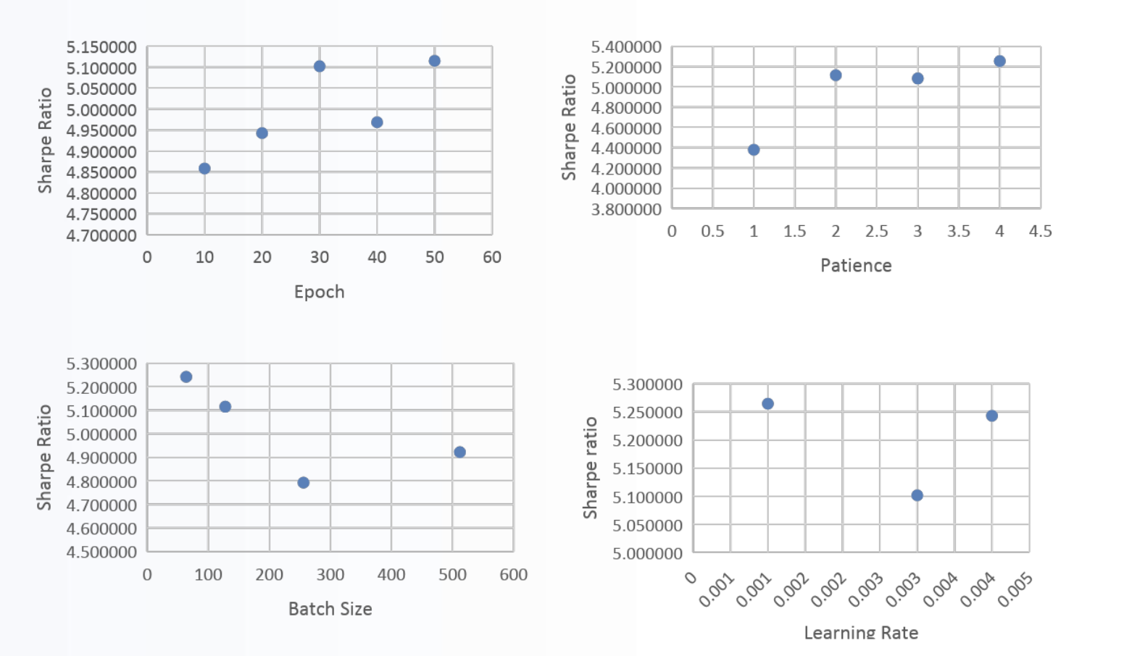
1
HYPERPARAMETER TUNING AND THE BEST IDENTIFIED
Notes:
HS

Slide 38
THANK YOU!

